Slide 1

Presentation on E-Commerce Website
Project Title : QuickPick - E-Commerce Website
Team Members –
1. Gauri Sawant
2. Pranita Danve
3. Meghana Deshpande
4. Gauri Gaikwad
5. Sai Phapale
6. Varad Karve
7. Yash Deshpande
8. Swaraj Bhagat
9. Sneha Tipugade

Slide 2
Company Details
Tayan Solutions - TayanS is a leading IT company specializing in providing innovative and
comprehensive technology solutions to businesses across various industries.
With a deep understanding of the rapidly evolving digital landscape, we offer a wide range of
services designed to help our clients leverage technology for growth and success. Our dedicated
team of experts combines technical expertise with strategic thinking to deliver tailor-made
solutions that drive efficiency, productivity, and competitive advantage.
Vision: Our vision is to be a trusted partner for businesses in digital technology space,
empowering them with cutting-edge technology solutions and fostering their digital
transformation journey. We strive to create a future where technology is seamlessly integrated
into every aspect of business operations, unlocking new opportunities and driving sustainable
growth.
Mission: At TayanS, our mission is to deliver exceptional IT solutions that enable our clients to
stay ahead in the ever-changing digital landscape. We are committed to providing personalized,
reliable, and cost-effective IT Solutions and services that cater to the unique needs of each
organization.

Slide 3
Introduction :-
QuickPick is a front-end e-commerce website developed using HTML, CSS, Bootstrap, and JavaScript. It offers users a modern online shopping experience with features like product browsing, category filtering, cart management, and a contact page. This project provided hands-on experience in designing responsive interfaces and implementing interactive website functionalities.
Purpose:-
The main purpose of QuickPick is to simulate a real online store while helping developers practice and apply core web development concepts. It focuses on building a user-friendly, responsive interface without the complexity of databases or user authentication. The project aims to improve understanding of how e-commerce platforms work and enhance front-end development skills.

Slide 4
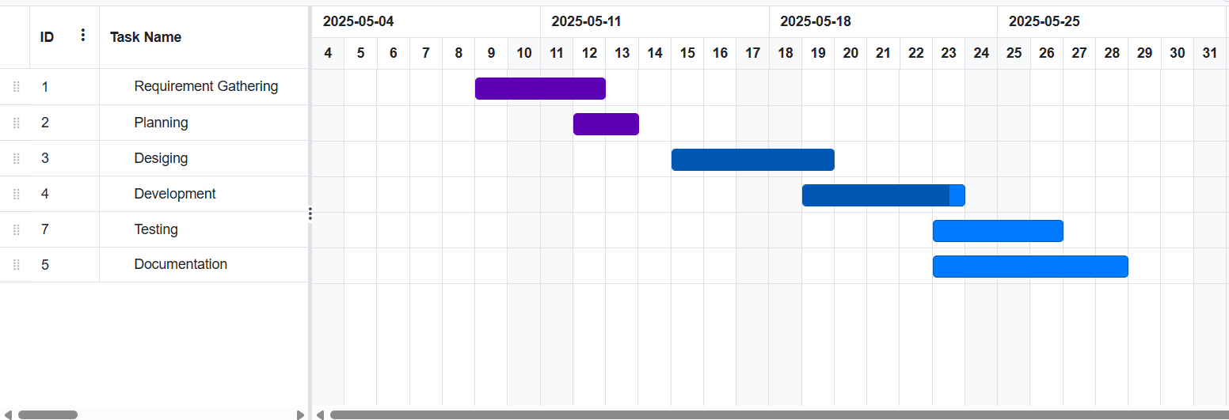
Roles and Timeline
Designing – Sai Phapale, Pranita Danve
Development – Varad Karve, Meghana Deshpande, Gauri Sawant
Testing – Swaraj Bhagat, Sneha Tipugade
Documentation – Gauri Gaikwad, Yash Deshpande

Slide 5
Objectives
To develop a fully functional e-commerce website using HTML, CSS, and JavaScript.
To implement product browsing, category filtering, and cart management features.
To create a responsive design that works well on both desktop and mobile devices.
To enhance user engagement through contact forms and interactive UI.
To gain practical experience in web development and teamwork.

Slide 6
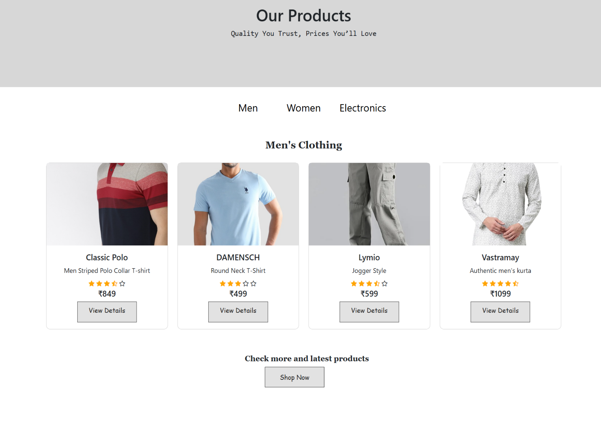
Features Overview
Product Listing Page

Slide 7
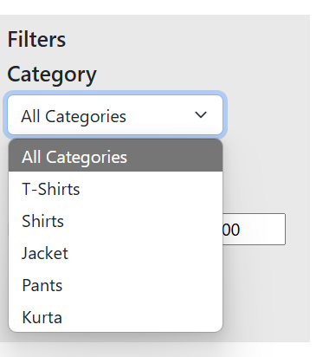
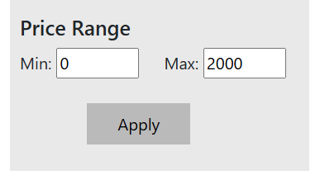
Category-Based Filtering
Price Range filter

Slide 8
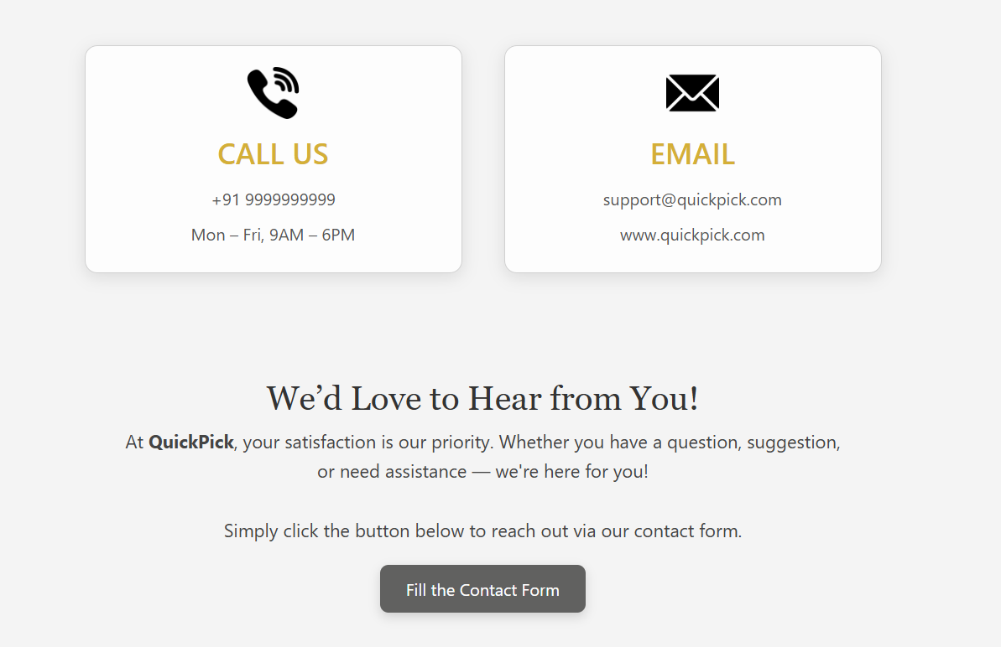
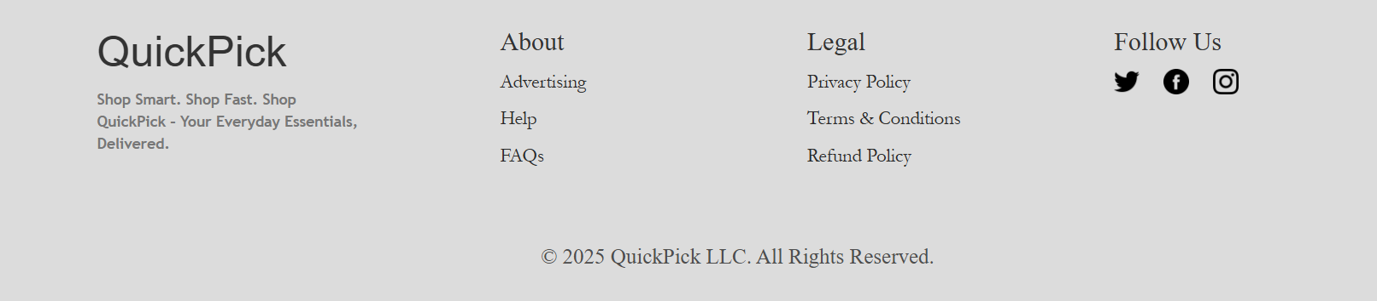
Contact Form &
Customer Care Section
Fully Responsive Design
Footer with Social Media and Policy Links

Slide 9
Tools & Technologies Used
Frontend Technologies: HTML5, CSS3, JavaScript, Bootstrap
Code Editor: Visual Studio Code
Version Control: Git & GitHub (for code collaboration and backup)
Design Tools: Canva (used for UI planning and slide design)
Development & Testing Platform: Windows Operating System

Slide 10
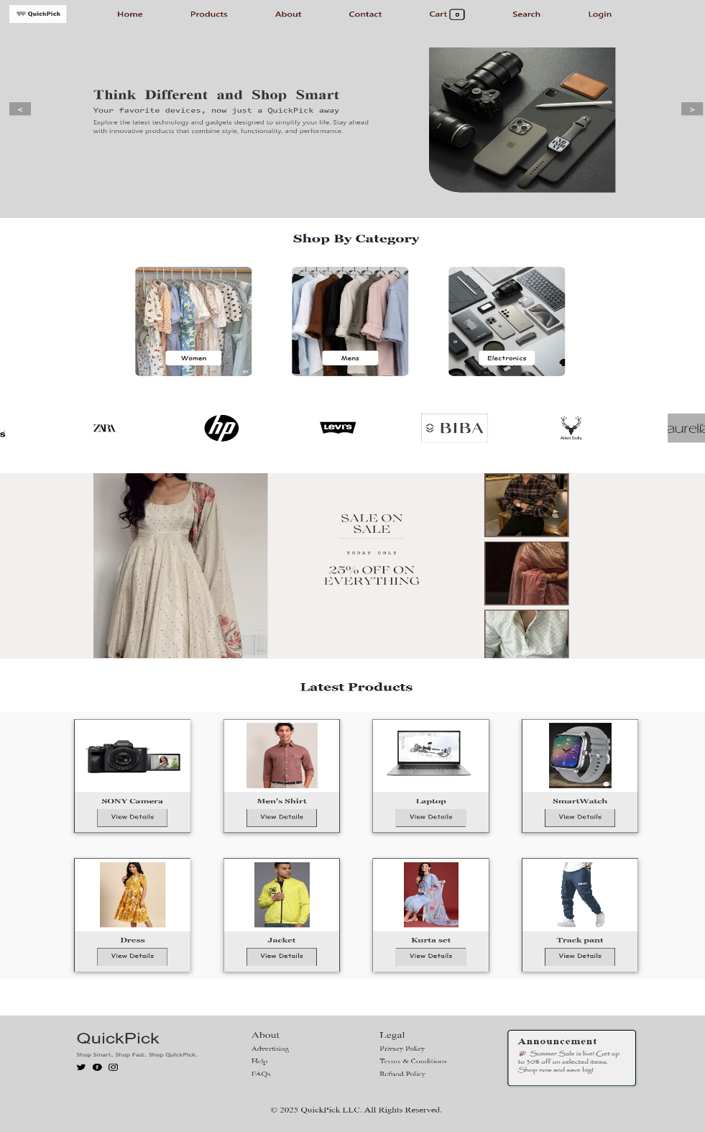
User Interface (UI)
Home Page
Consistent color theme and layout
Easy navigation and clean design
Responsive menu for mobile devices

Slide 11
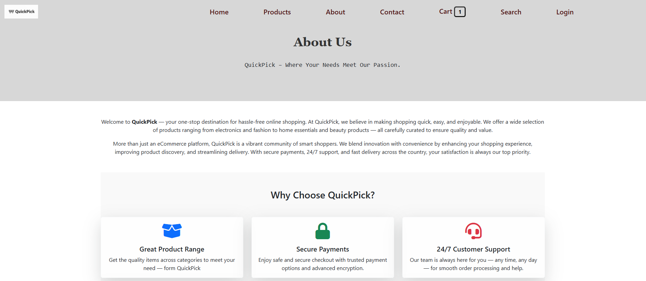
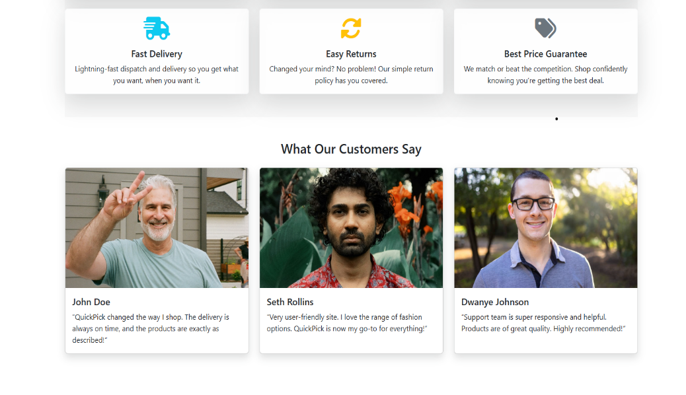
About us Page

Slide 12
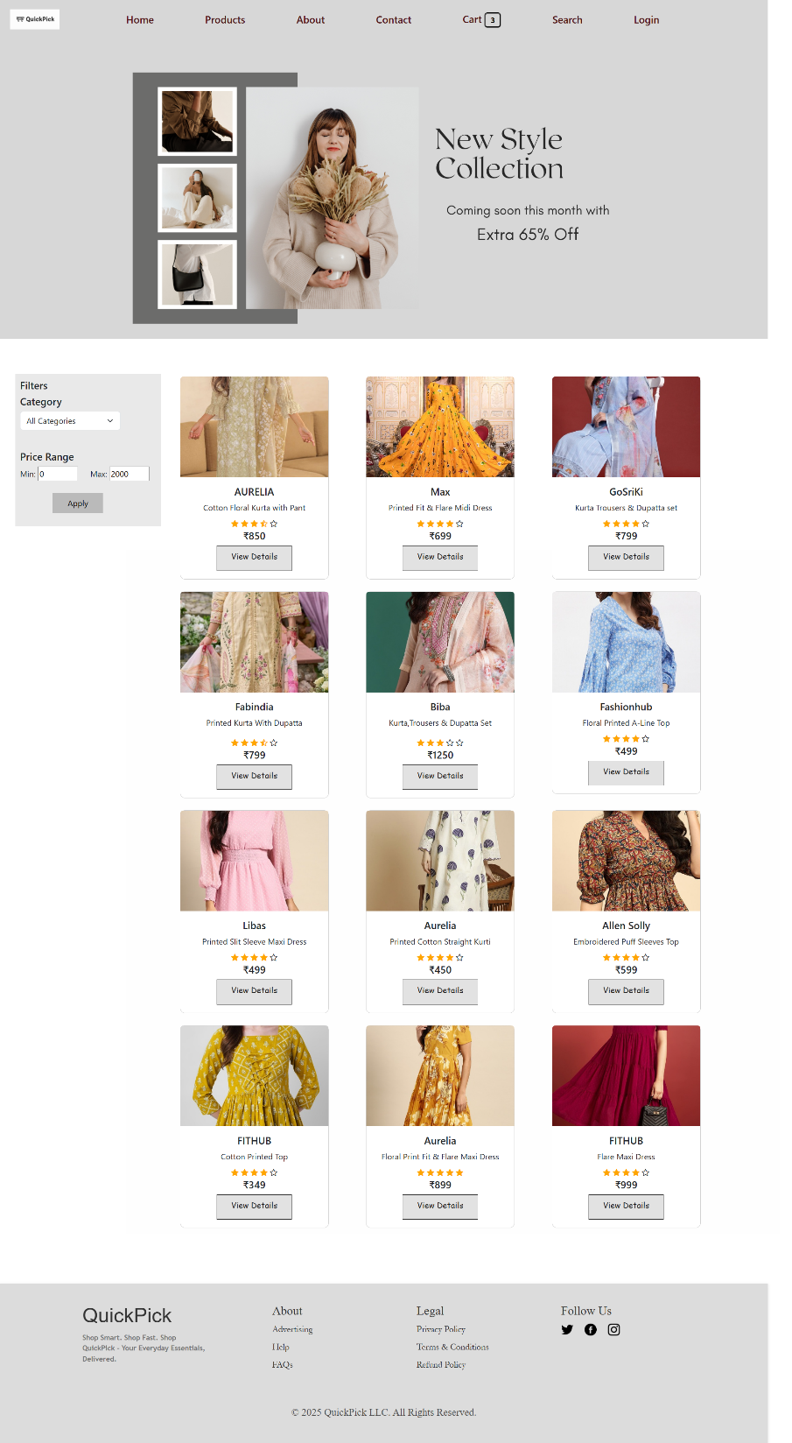
Women’s Clothing Page
Note - Also for men’s and electronics products we have created different pages

Slide 13
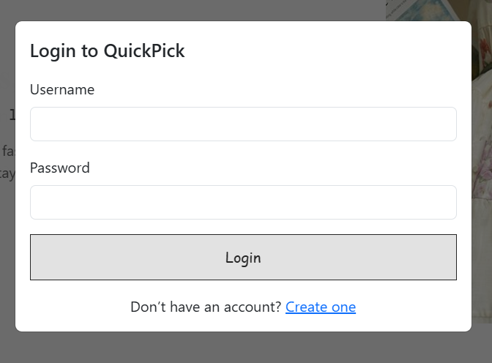
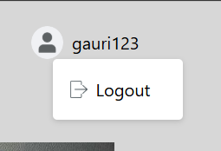
Login and Account creation pop-up box
Username name and logout button

Slide 14
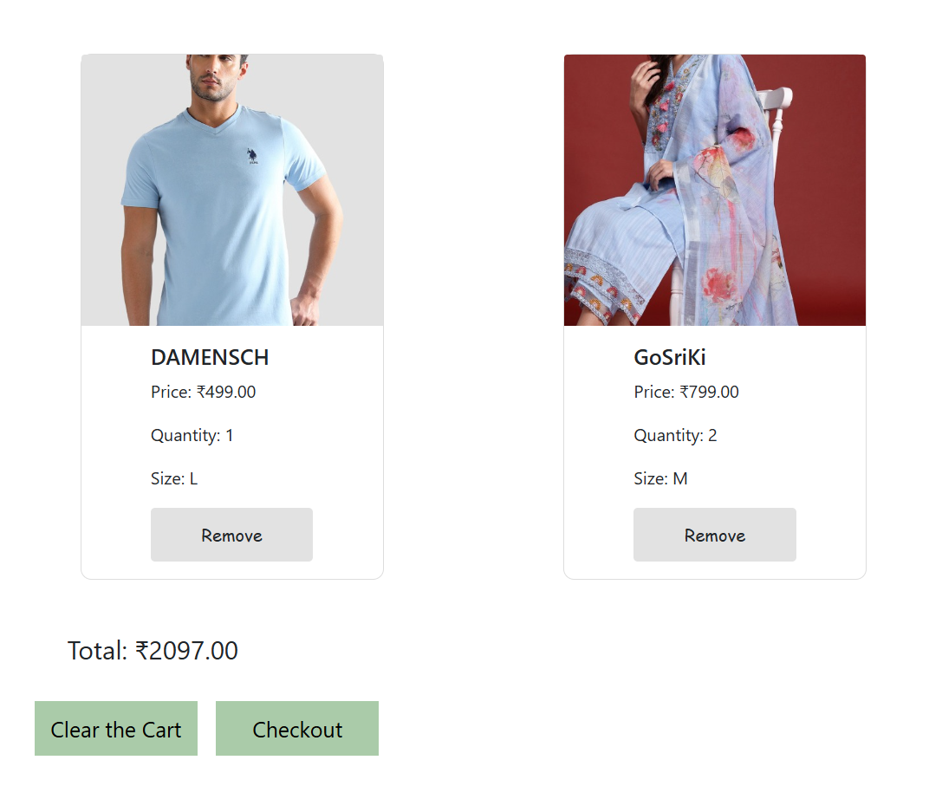
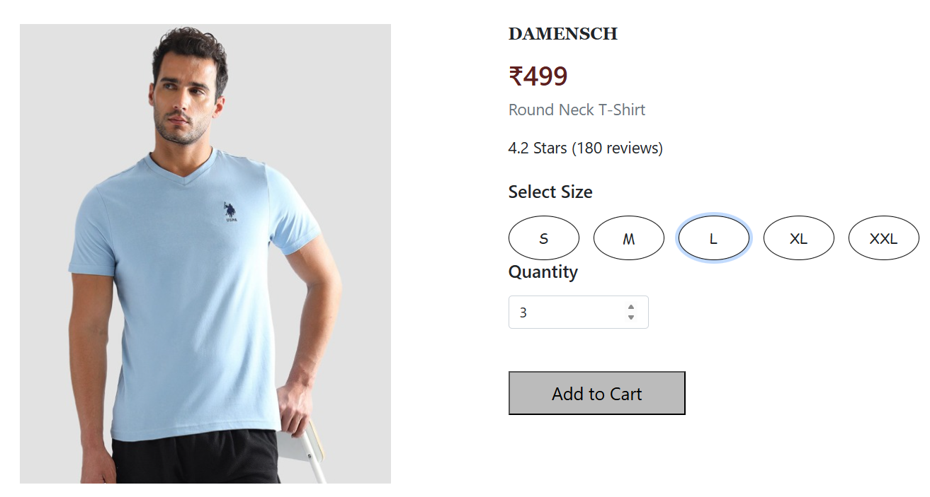
Key Functionalities
Adjust Quantity for each
product also Select size option
Remove Products , Clear Cart
and Checkout

Slide 15
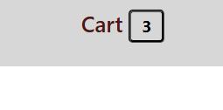
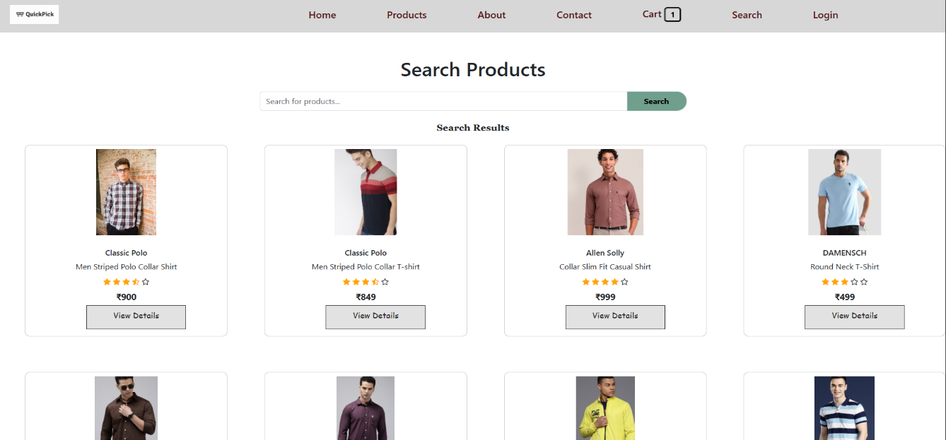
Show the count of products in cart
Search products

Slide 16
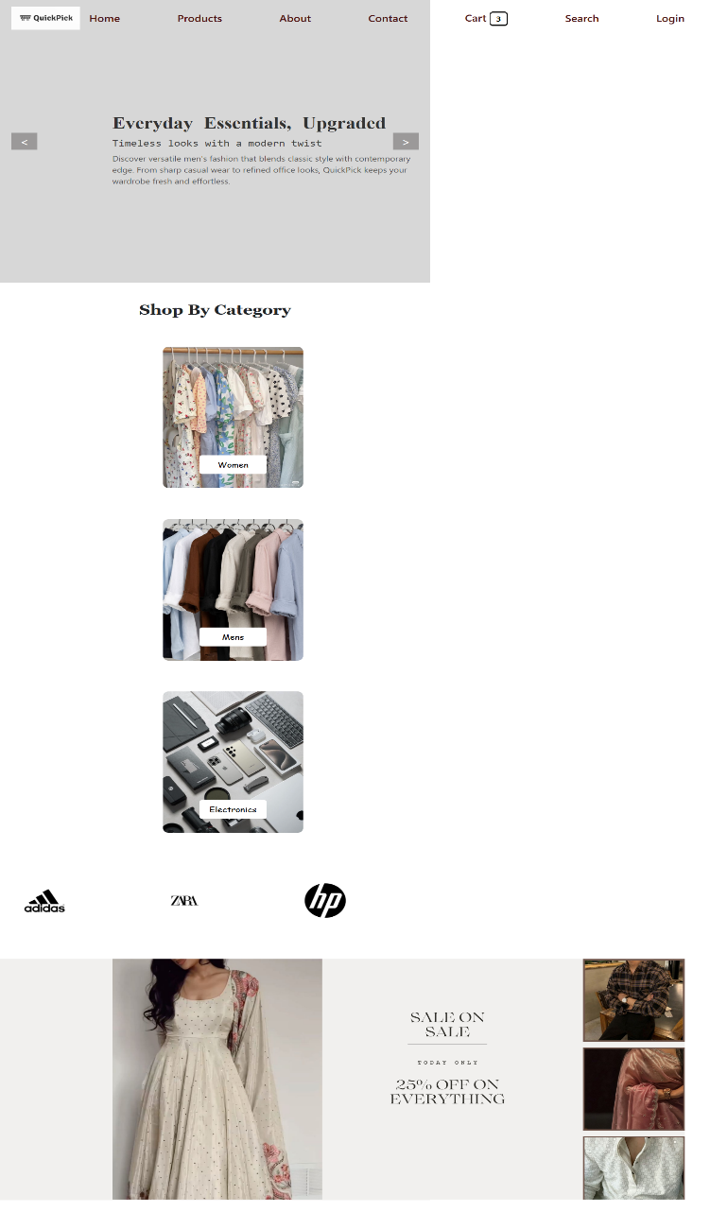
Challenges Faced
CSS alignment issues across screen sizes
Cart update logic in JavaScript
Responsive design testing
Debugging UI elements on mobile view

Slide 17
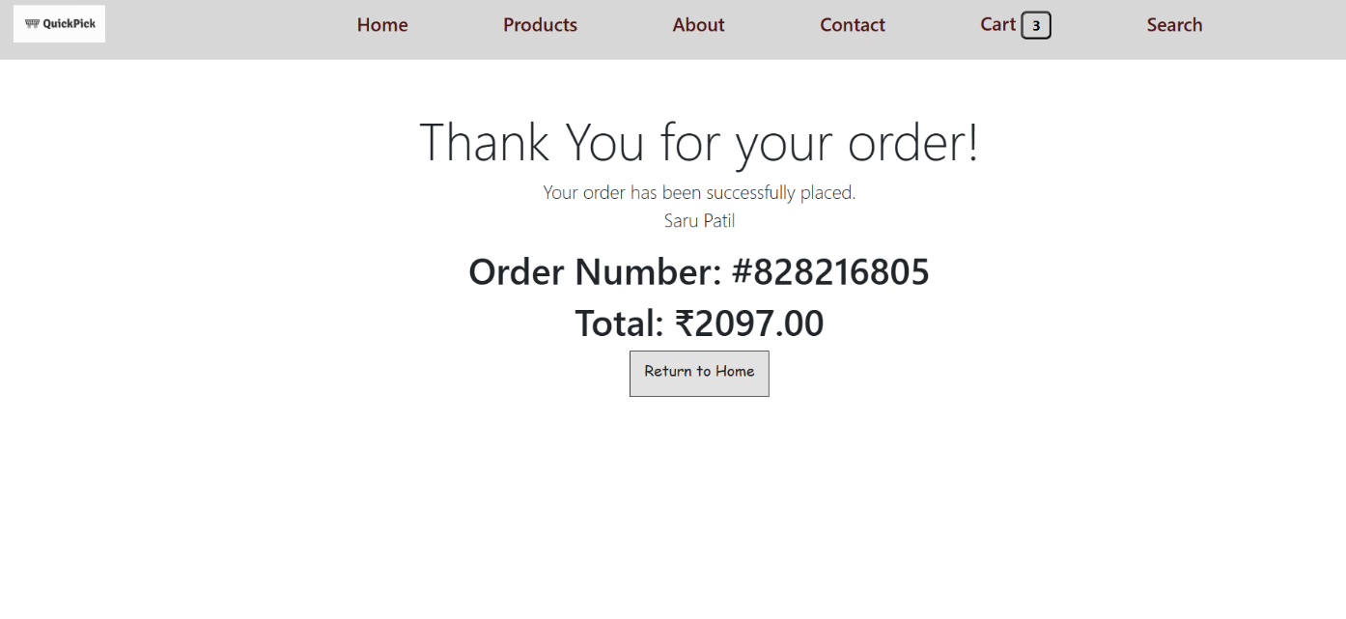
Learning Outcomes
Mastered HTML, CSS, and JavaScript basics
Learned DOM manipulation and responsive design
Understood team collaboration and project workflow
Gained hands-on experience in real-world web development

Slide 18
Conclusion
QuickPick successfully meets all objectives, offering a fully functional e-commerce experience with modern UI and interactivity. We have improved our technical skills and developed confidence in building and presenting a complete web project. Future scope includes adding backend integration and payment gateway support.

Slide 19
Thank You!!

